Slide 1
Microprocessor System Design
Omid Fatemi
80x86 Addressing modes
(omid@fatemi.net)

Slide 2
Review
Programs for 80x86
Machine language, Assembly, …
Registers, segments
Instruction set
Simple program
Logical, physical address
Stack

Slide 3
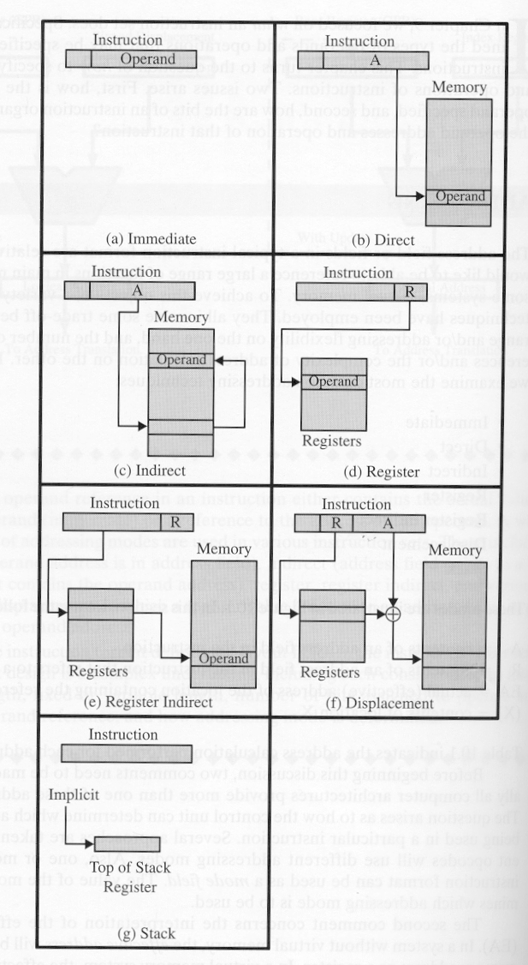
Addressing Modes
Operands in an instruction
Registers AX
Numbers → immediate 12H
Memory
Direct addressing [3965]
Register indirect [BX]
Based relative addressing mode [BX+6], [BP]-10
Indexed relative addressing mode [SI+5], [DI]-8
Based indexed addressing mode [BX+SI+5]

Slide 4
Operand types
1) Register - Encoded in instruction
• Fastest executing
• No bus access (in instr. queue)
• Short instruction length
2) Immediate - Constant encoded in instruction
• 8 or 16 bits
• No bus access (in instr. queue)
• Can only be source operand
3) Memory – in memory, requires bus transfer
• Can require computation of address
• Address of operand DATA is Called
EFFECTIVE ADDRESS

Slide 5
Effective Address
Computed by EU
In General, Effective address =
displacement + [base register]+ [index register]
(if any) (if any)
Any Combination of These 3 Values
Leads to Several Different Addressing Modes
Displacement
8 or 16 bit Constant in the Instruction
“base register” Must be BX or BP
“index register” Must be SI or DI

Slide 6
Direct Addressing
mov [7000h], ax
ds:7000h
ax
A3 00 70
mov es:[7000h], ax
26 A3 00 70
es:7000h
ax
prefix byte
- longer instruction
- more fetch time
opcode
mod r/m
displacement
effective address

Slide 7
Register Indirect Addressing
mov al, [bp] ;al gets 8 bits at SS:BP
mov ah, [bx] ;ah gets 8 bits at DS:BX
mov ax, [di] ;ax gets 16 bits at DS:SI
mov eax, [si] ;eax gets 32 bits at DS:SI
opcode
mod r/m
BX
BP
effective address
SI
DI

Slide 8
Based Indirect Addressing
mov al, [bp+2] ;al gets 8 bits at SS:BP+2
mov ah, [bx-4] ;ah gets 8 bits at DS:BX-4
opcode
mod r/m
displacement
BX
+
BP
effective address

Slide 9
Indexed Indirect Addressing
mov ax, [si+1000h] ;ax gets 16 bits at DS:SI+1000h
mov eax, [si+300h] ;eax gets 32 bits at DS:SI+300h
Mov [di+100h], al ;DS:DI+100h gets 8 bits in al
opcode
mod r/m
displacement
DI
+
SI
effective address

Slide 10
Based Indexed Indirect Addressing
mov ax, [bp+di] ;ax gets 16 bits at SS:BP+DI
mov ax, [di+bp] ;ax gets 16 bits at DS:BP+DI
mov eax, [bx+si+10h] ;eax gets 32 bits at DS:BX+SI+10h
mov cx, [bp+si-7] ;cx gets 16 bits at SS:BP+SI-7
opcode
mod r/m
displacement
DI
+
SI
BX
+
BP
effective address

Slide 11
Addressing Mode Examples
mov al, bl ;8-bit register addressing
mov di, bp ;16-bit register addressing
mov eax, eax ;32-bit register addressing
mov al, 12 ;8-bit immediate, al<-0ch
mov cx, faceh ;16-bit immediate, cx<-64,206
mov ebx, 2h ;32-bit immediate, ebx<-00000002h
mov al, LIST ;al<-8 bits stored at label LIST
mov ch, DATA ;ch<-8 bits stored at label DATA
mov ds, DATA2 ;ds<-16 bits stored at label DATA2
mov al, [bp] ;al<-8 bits stored at SS:BP
mov ah, [bx] ;ah<-8 bits stored at DS:BX
mov ax, [bp] ;ax<-16 bits stored at SS:BP
mov eax, [bx] ;eax<-32 bits stored at DS:BX
mov al, [bp+2] ;al<-8 bits stored at SS:(BP+2)
mov ax, [bx-4] ;ax<-16 bits stored at DS:(BX-4)
mov al, LIST[bp] ;al<-8 bits stored at SS:(BP+LIST)
mov bx, LIST[bx] ;bx<-16 bits stored at DS:(BX+LIST)
mov al, LIST[bp+2] ;al<-8 bits stored at SS:(BP+2+LIST)
mov ax, LIST[bx-12h] ;ax<-16 bits stored at DS:(BX- 18+LIST)
Register
Immediate
Direct
Based

Slide 12
More Addressing Mode Examples
mov al, [si] ;al<-8 bits stored at DS:SI
mov ah, [di] ;ah<-8 bits stored at DS:DI
mov ax, [si] ;ax<-16 bits stored at DS:SI
mov eax, [di] ;eax<-32 bits stored at DS:DI
mov ax, es:[di] ;ax<-16 bits stored at ES:DI
mov al, [si+2] ;al<-8 bits stored at DS:(SI+2)
mov ax, [di-4] ;ax<-16 bits stored at DS:(DI-4)
mov al, LIST[si] ;al<-8 bits stored at DS:(SI+LIST)
mov bx, LIST[di] ;bx<-16 bits stored at DS:(DI+LIST)
mov al, LIST[si+2] ;al<-8 bits stored at DS:(SI+2+LIST)
mov ax, LIST[di-12h] ;ax<-16 bits stored at DS:(DI-18+LIST)
mov al, [bp+di] ;al<-8 bits from SS:(BP+DI)
mov ah, ds:[bp+si] ;ah<-8 bits from DS:(BP+SI)
mov ax, [bx+si] ;ax<-16 bits from DS:(BX+SI)
mov eax, es:[bx+di] ;eax<-32 bits from ES:(BX+DI)
mov al, LIST[bp+di] ;al<-8 bits from SS:(BP+DI+LIST)
mov ax, LIST[bx+si] ;ax<-16 bits from DS:(BX+SI+LIST)
mov al, LIST[bp+di-10h] ;al<-8 bits from SS:(BP+DI-16+LIST)
mov ax, LIST[bx+si+1AFH] ;ax<-16 bits from DS:(BX+SI+431+LIST)
Indexed
Based
Indexed

Slide 13
Instruction Format (opcode, d, w)
7
0
low addr
opcode
d
w
mod
reg
r/m
optional
Low Displacement or Immediate
optional
High Displacement or Immediate
optional
Low Immediate
high addr
optional
High Immediate
opcode 6-bit value that specifies instruction type
d is 1-bit value that specifies destination
d=0 for memory and d=1 for register
w is 1-bit value that specifies if destination is word or byte
w=0 for byte and w=1 for word

Slide 14
Instruction Format (reg, mod)
7
0
low addr
opcode
d
w
mod
reg
r/m
optional
Low Displacement or Immediate
optional
High Displacement or Immediate
optional
Low Immediate
high addr
optional
High Immediate
mod is 2-bit value that indicates addressing mode
(along with r/m value)
reg is 3-bit value that specifies a (destination) register
(see table to right) or opcode extension
r/m is 3-bit value that specifies operand location
(r/m means register/memory)

Slide 15
Instruction Format (displacement)
7
0
low addr
opcode
d
w
mod
reg
r/m
optional
Low Displacement or Immediate
optional
High Displacement or Immediate
optional
Low Immediate
high addr
optional
High Immediate
Displacement may be either 8 or 16 bits
- signed integer encoded into instruction
- used in computation of operand address
Immediate may be 8, 16 or 32 bits
- signed integer
- used as an actual operand

Slide 16
Instruction Format Example
7
0
low addr
opcode
d
w
mod
reg
r/m
optional
Low Displacement or Immediate
optional
High Displacement or Immediate
optional
Low Immediate
high addr
optional
High Immediate
Consider the Instruction: mov ax, bx
The Assembler translates this into: 8B C3
opcode is: 100010 mov
d is: 1 destination is register
w is: 1 destination size = 1 word
mod is: 11 this indicates that r/m specifies a register
reg is: 000 destination register is ax
r/m is: 011 source register is bx

Slide 17
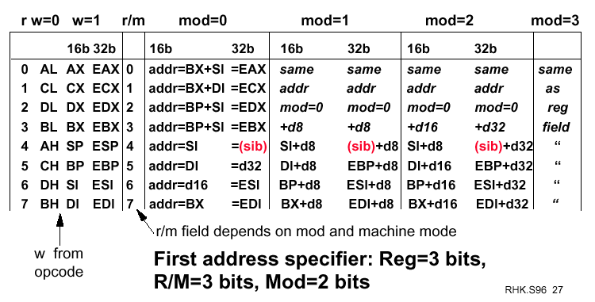
Instruction Format (mod)

Slide 18
Assembler versus Machine Code
ADD AX, BX ;AX gets value AX+BX
SUB AX, BX ;AX gets value AX-BX
AND AX, BX ;AX gets bitwise AND of AX and BX
INC AX ;AX gets its original value plus 1
DEC BX ;BX gets its original value minus 1
MOV AX, BX ;AX gets values in BX
93ee:db1e
93ee:db1f
93ee:db20
93ee:db21
93ee:db22
93ee:db23
93ee:db24
93ee:db25
93ee:db26
93ee:db27
01
D8
29
D8
21
D8
40
4B
8B
C3
a19fe
a19ff
a1a00
a1a01
a1a02
a1a03
a1a04
a1a05
a1a06
a1a07
ASSEMBLER
01 D8
29 D8
21 D8
40
4B
8B C3
01 D8
29 D8
21 D8
40
4B
8B C3
LINKER
LOADER
logical
address
physical
memory
physical
address

Slide 19
I/O Port Addressing
x86 family has 65,536 I/O ports
Each port has address (like memory)
Referred to as “I/O memory space”
I/O port is 1 byte or 2 bytes
with 386+ also 4 bytes
Two addressing modes
1) Direct port address
- Can only be 1 byte
- Can only be address ports 00h through ffh
2) Port address present in DX
- Can address all ports 0000h through ffffh
Can only use DX for port addresses
Can only use AL,AX,EAX for port data

Slide 20
Flag Register
15
0
x
x
x
x
OF
DF
IF
TF
SF
ZF
x
AF
x
PF
x
CF
CF Carry Flag Arithmetic Carry/Borrow
OF Overflow Flag Arithmetic Overflow
ZF Zero Flag Zero Result; Equal Compare
SF Sign Flag Negative Result; Non-Equal
PF Parity Flag Even Number of “1” bits
AF Auxiliary Carry Used with BCD Arithmetic
DF Direction Flag Auto-Increment/Decrement
(used for “string operations”)
IF Interrupt Flag Enables Interrupts
(allows “fetch-execute” to be interrupted)
TF Trap Flag Allows Single-Step
(for debugging; causes interrupt after each op)

Slide 21
80x86 Family
16-bit Processors
8088 (8-bit data / 20-bit address)
8086/186 (16-bit data / 20-bit address)
80286 (16-bit data / 24-bit address)
32-bit Processors
80386 (16/24 or 32/32 common)
80486 (32/32), Pentium, PII (64/32)
Pentium Pro, II, III, IV (64/36)
PPC 60x (32 or 64/32)
All 80x86 processors use a 16-bit address for i/o
Notes:
We have to go to 16-bit micro to explain later about IO interfacing in them.

Slide 22
8 And 16 bit Organizations
8088
Data is organized into byte widths
The 1MB memory is organized as 1M x 8-bits
8086/80186
Data is organized into word widths
The 1MB memory is organized as 512k x 16-bits
80286/80386SX
Data is organized into word widths
The 16MB memory is organized as 8M x 16-bits

Slide 23
32 and 64 bit Organizations
• 80386DX/80486
– Data is organized into double word widths
– The 4GB memory is organized as 1G x 32-bits
• Pentium Pro/Pentium 1-4
– Data is organized into quad word widths
– The 4GB memory is organized as 512M x64-bits
(on P2-4, actual address bus is 36 bits)

Slide 24
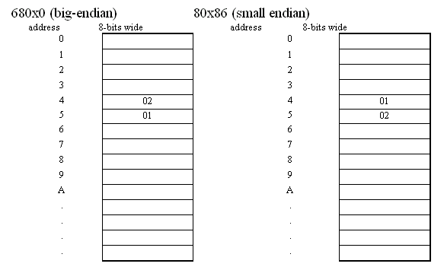
Little Endian / Big Endian
for the 68000:
MOVE.W #513, D0 ; move value 513 into the lower 16 bits of D0
MOVE.W D0,4 ; store the lower word of D0 into memory 4
for the 80x86:
MOV AX,513 ; load AX (16 bits), with the value 513
MOV [4],AX ; store AX into memory 4
Notes:
Etymology[edit]
Wikisource has original text related to this article:Gulliver's Travels (Part I, Chapter IV)
In 1726, Jonathan Swift described in his satirical novel Gulliver’s Travels tensions in Lilliput and Blefuscu: whereas royal edict in Lilliput requires cracking open one's soft-boiled egg at the small end, inhabitants of the rival kingdom of Blefuscu crack theirs at the big end (giving them the moniker Big-endians).^{[1][2]} The terms little-endian and endianness have a similar intent.^{[3]}
Danny Cohen's "On Holy Wars and a Plea for Peace" published in 1980^{[2]} ends with: "Swift's point is that the difference between breaking the egg at the little-end and breaking it at the big-end is trivial. Therefore, he suggests, that everyone does it in his own preferred way. We agree that the difference between sending eggs with the little- or the big-end first is trivial, but we insist that everyone must do it in the same way, to avoid anarchy. Since the difference is trivial we may choose either way, but a decision must be made."
This trivial difference was the reason for a hundred-years war between the fictional kingdoms. It is widely assumed that Swift was either alluding to the historic War of the Roses or – more likely – parodying through oversimplification the religious discord in England, Ireland and Scotland brought about by the conflicts between theRoman Catholics (Big Endians) on the one side and the Anglicans and Presbyterians (Little Endians) on the other.

Slide 25
Summary
Operands
Addressing modes
IO ports
Flag
Memory alignment

